Slide 1
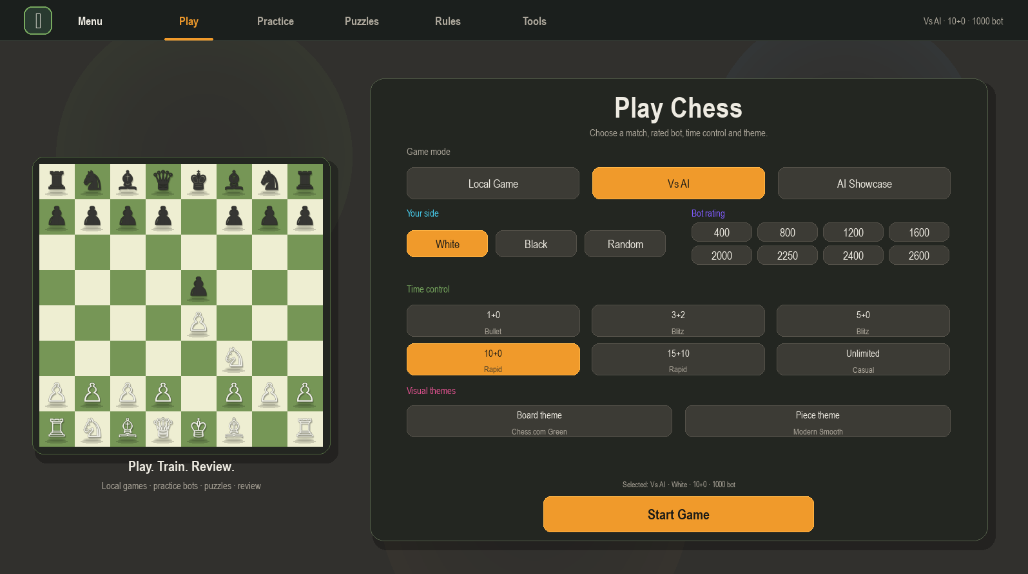
♞
Henry’s Chess Engine
Major Project Client Handover
Advanced Python/Pygame desktop chess app with rated bots, puzzles, premove support, Stockfish-powered game review, graphical annotations, themes and executable deployment.
53+
12
2600
GitHub commits
automated tests
top bot rating
Copyright & source acknowledgement
Initial chess-engine learning foundation acknowledged from Eddie Sharick’s “Chess Engine in Python” YouTube series. Final solution has been extended with original UI, rated bots, Stockfish review, puzzles, premove, annotations, deployment support, testing and documentation. Stockfish is acknowledged as third-party open-source UCI software.
GitHub: HenryPham3023 / Henry-Pham-Chess
Slide 1 • Title, source acknowledgement and project identity
Notes:
Introduce the project as a simulated client handover. Acknowledge Eddie Sharick as the source of the original learning/tutorial foundation and make clear that the submitted project has been heavily modified and extended into a larger advanced desktop application.

Slide 2
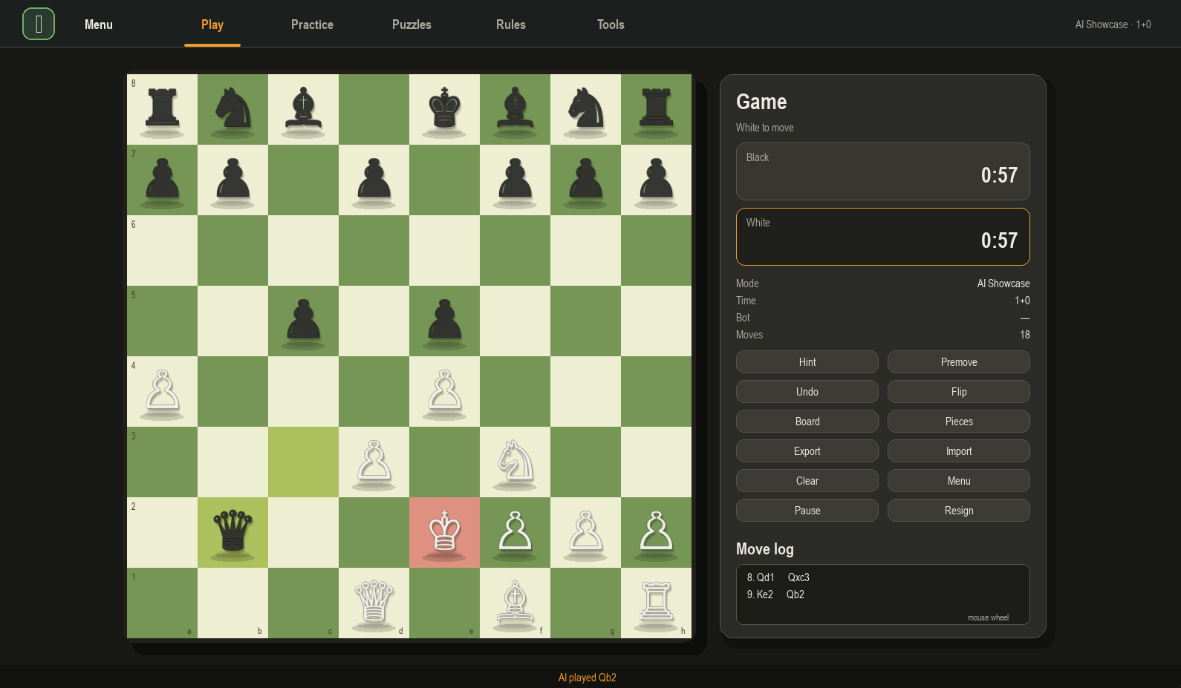
Problem Statement & User Need
Problem
Many beginner chess apps either teach rules without realistic gameplay or provide engine analysis without explaining it clearly. The opportunity was to build an offline desktop app that combines playing, training and review in one place.
Users
Need
Benefit
Students, casual players, classmates and teachers.
Learn chess while playing against varied bot strengths.
Immediate feedback through puzzles, hints and Game Review.
Why chess?
Rules-based system suited to software engineering
Complex enough to demonstrate algorithms and edge cases
Easy to demonstrate live to a simulated client
Henry Chess • Year 12 Software Engineering Major Project • Advanced desktop app • Python/Pygame • Stockfish review • PyInstaller deployment
Notes:
Explain that the project was selected because chess is a realistic software engineering problem. It requires data structures, algorithms, UI design, testing and defensive handling of edge cases.

Slide 3
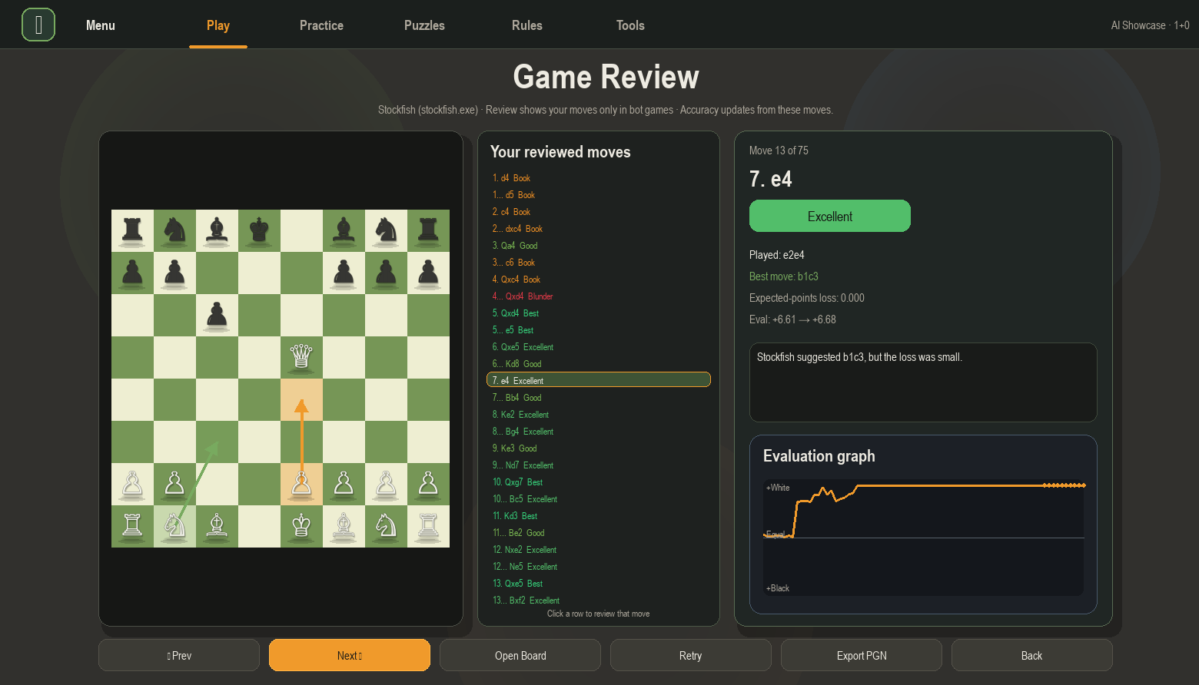
Final Product Snapshot
A complete chess learning platform rather than only a board.
Local multiplayer
Rated bots
Puzzle training
Stockfish review
Premove + annotations
Executable build
Henry Chess • Year 12 Software Engineering Major Project • Advanced desktop app • Python/Pygame • Stockfish review • PyInstaller deployment
Notes:
Use this slide to give a quick tour of the final product. Point to the menu on the left and Game Review on the right.

Slide 4
Methodology & Project Management
WAgile approach
Evidence produced
The project used a hybrid method: Waterfall-style planning for requirements and diagrams, then Agile sprint cycles for build-test-refine improvements.
Gantt chart and logbook
Risk matrix and requirements list
GitHub commit history
Testing + refinement notes
Feb
Mar
Apr
May
Jun
Jul
Approval, scope, requirements
Core chess rules + UI
AI, special moves, testing
Puzzles, bots, Stockfish
Executable + documentation
Handover + presentation
Why this suited the project
Chess development involved uncertain bugs, UI feedback and AI behaviour tuning. Iterative testing allowed the solution to become more stable and user-focused over time.
Henry Chess • Year 12 Software Engineering Major Project • Advanced desktop app • Python/Pygame • Stockfish review • PyInstaller deployment
Notes:
Explain that the documentation contains the full Gantt chart and logbook. The presentation summarises the approach for the simulated client.

Slide 5
Technologies & Tool Justification
Python
Pygame
VS Code
Clear syntax, strong education use and suitable for algorithms.
Real-time desktop graphics, input handling and sound.
Used for coding, terminal testing and file structure management.
GitHub
Stockfish
PyInstaller
Version control, commit history, README and release evidence.
External UCI engine used for stronger review and high-rated bots.
Creates downloadable executable so app runs outside the IDE.
Selection logic: tools were chosen for reliability, local offline deployment, visible UI output and alignment with the Software Engineering advanced app requirement.
Henry Chess • Year 12 Software Engineering Major Project • Advanced desktop app • Python/Pygame • Stockfish review • PyInstaller deployment
Notes:
Justify each tool. The task asks for tool justification, programming language justification, documentation tools, testing tools and security programming discussion.

Slide 6
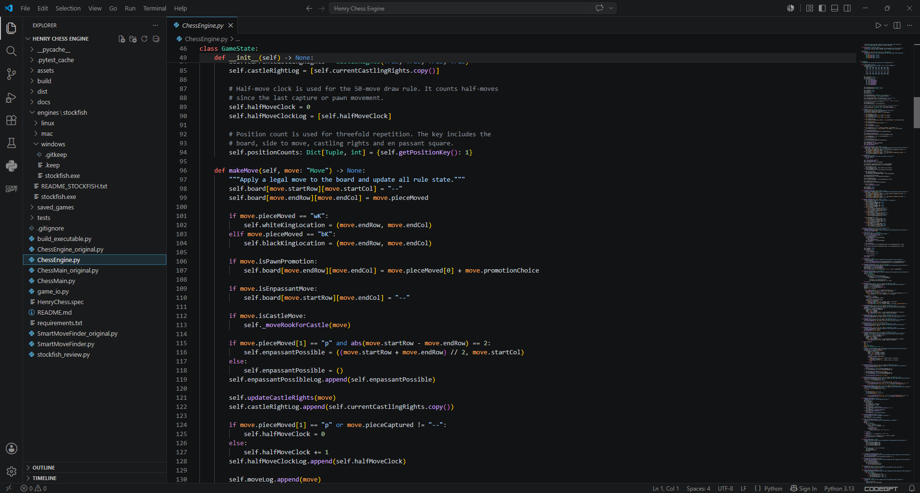
System Architecture
Separation of responsibilities keeps the project maintainable.
ChessMain.py
ChessEngine.py
SmartMoveFinder.py
stockfish_review.py
Pygame interface, game loop, tabs, input, drawing and user interaction.
Board state, legal moves, special rules, checkmate and draw logic.
Internal AI, bot personalities, move ordering and fallbacks.
UCI communication, best moves, evaluations and game review.
High-level flow
User selects mode, side, bot and time control
UI sends moves to GameState for validation
AI/Stockfish modules provide bot move or review data
GameSession preserves state between tabs and review screens
Henry Chess • Year 12 Software Engineering Major Project • Advanced desktop app • Python/Pygame • Stockfish review • PyInstaller deployment
Notes:
Point out the modular file structure from VS Code. This directly supports the Component B criteria for modularisation, code structure and maintainability.

Slide 7
Code Quality & Design Alignment
Evidence of standardised code
Meaningful class/function names
Docstrings and inline comments explaining purpose
Separate modules for engine, UI, AI, review and I/O
Defensive checks around external files and Stockfish
PEP 8-style indentation and readable control flow
Why this matters
The app can be extended without rewriting the engine. UI changes, bot tuning and review improvements are isolated from legal move generation.
Henry Chess • Year 12 Software Engineering Major Project • Advanced desktop app • Python/Pygame • Stockfish review • PyInstaller deployment
Notes:
Discuss how the code aligns with the UML and documentation. Emphasise that comments explain why code exists, not only what individual lines do.

Slide 8
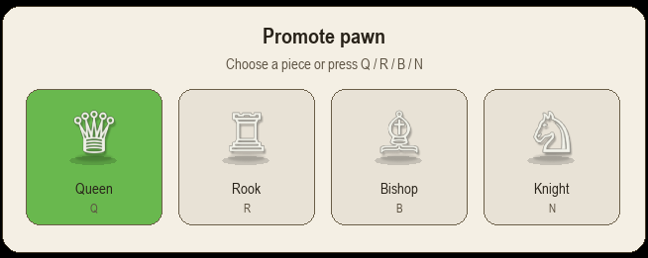

Core Gameplay Features
Complete chess rule handling
Legal moves
Castling
En passant
Promotion
Checkmate
Premove
Arrows
Themes
Henry Chess • Year 12 Software Engineering Major Project • Advanced desktop app • Python/Pygame • Stockfish review • PyInstaller deployment
Notes:
Demonstrate the board in the live demo. Highlight promotion popup and premove arrows as interactive features that go beyond a basic chess board.

Slide 9
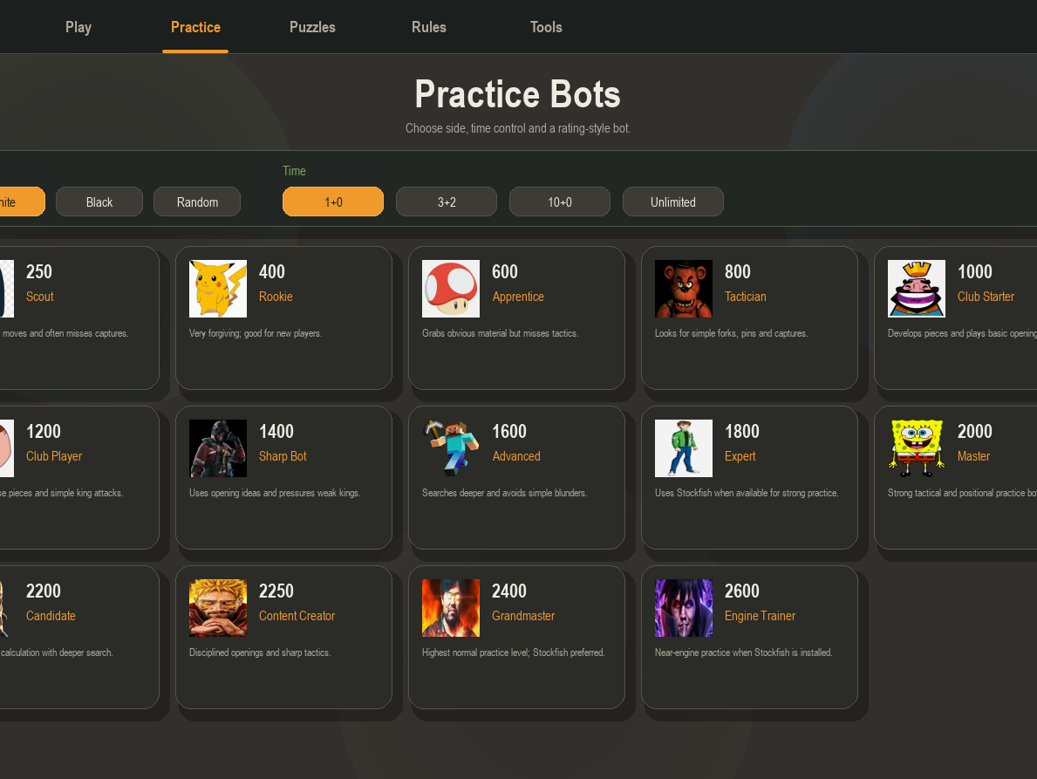
Rated Bots & AI Behaviour
Bot rating model
Lower ratings deliberately miss simple tactics
Mid ratings use safer openings and basic development
Higher ratings search deeper and avoid obvious blunders
Stockfish is preferred for high-rated analysis when available
Thinking delay is tuned so bots feel less instant and more human
User value
Players can practise against opponents that feel different, rather than one generic random AI.
Henry Chess • Year 12 Software Engineering Major Project • Advanced desktop app • Python/Pygame • Stockfish review • PyInstaller deployment
Notes:
Mention that bot ratings are simulated through search depth, opening behaviour, mistake frequency and Stockfish integration. Acknowledge that this is a school-project approximation, not an official Elo system.

Slide 10
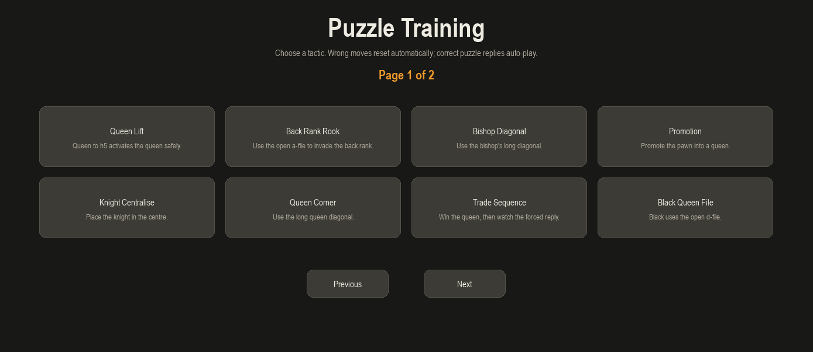
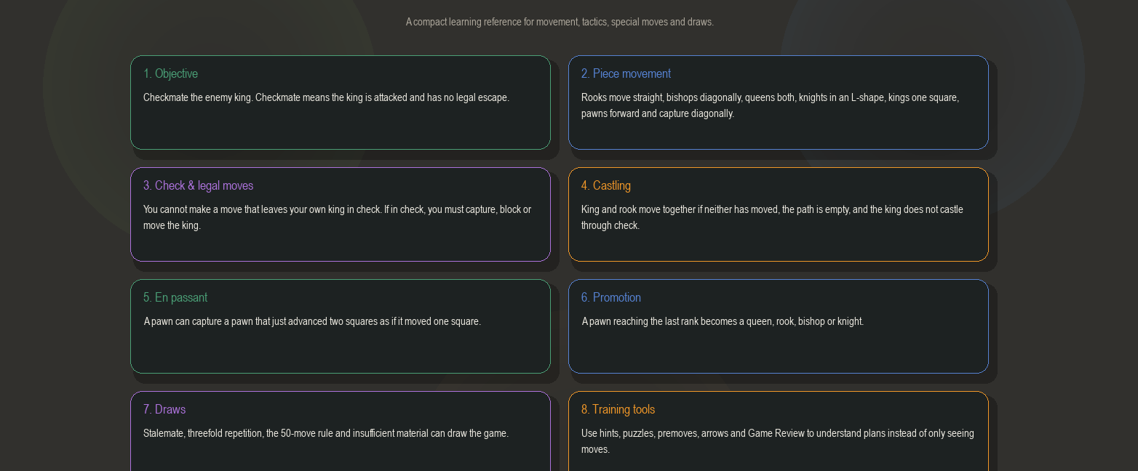
Training System: Puzzles, Rules & Learning Tools
Designed for learning, not only playing
Puzzle mode validates only the player move
Correct moves highlight green and forced replies auto-play
Wrong moves reset instead of corrupting the puzzle
Rules guide explains movement, check, castling, promotion and draws
Hints can use Stockfish and are blocked during the opponent’s turn
Assessment link
This feature proves user-focused refinement and demonstrates that the solution benefits players by teaching them how to improve.
Henry Chess • Year 12 Software Engineering Major Project • Advanced desktop app • Python/Pygame • Stockfish review • PyInstaller deployment
Notes:
Explain how puzzle bugs were found and fixed. This shows refinement and testing.

Slide 11
Stockfish-Powered Game Review
How the review works
1
Replay move log and rebuild board positions
2
Send FEN positions to Stockfish via UCI
3
Receive best move and evaluation
4
Classify player moves using expected-points loss
5
Display board, arrows, labels, graph and coach note
Player benefit
The review turns raw engine analysis into a clear learning interface: what was played, what was better, and how much the move affected the position.
Henry Chess • Year 12 Software Engineering Major Project • Advanced desktop app • Python/Pygame • Stockfish review • PyInstaller deployment
Notes:
This is one of the strongest advanced features. Mention Stockfish is optional and the app has a fallback if the executable is missing.

Slide 12
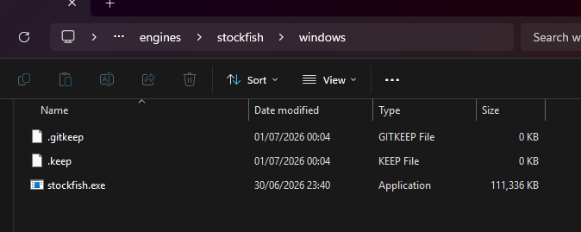
Defensive Programming & Reliability
Desktop safety focus
As a desktop app, the most relevant security requirements are defensive data handling, exception management, error handling and prevention of race-condition style AI crashes.
Stockfish fallback
File validation
If Stockfish is missing or crashes, the app keeps running using internal evaluation.
PGN/FEN imports are checked before being loaded into the board state.
Puzzle guards
State locking
Puzzle solution indexes are checked to avoid list out-of-range crashes.
Player moves, bot turns and premoves are kept within controlled game states.
Henry Chess • Year 12 Software Engineering Major Project • Advanced desktop app • Python/Pygame • Stockfish review • PyInstaller deployment
Notes:
Connect this to SE-12-07: desktop app defensive data handling, race conditions and error handling.

Slide 13
Testing & Refinement Evidence
Testing strategy
Automated unit tests using pytest
Syntax checking with py_compile
Manual testing of game modes and UI tabs
Edge cases: promotion, timeout, puzzle resets, Stockfish paths
User feedback used to refine layout, review and bot behaviour
12
144
5+
Refinement examples: fixed puzzle IndexError, menu overflow, game review crash after checkmate, Stockfish path handling, move log scrolling, timer expiry behaviour and high-rated bot performance.
tests passing
FPS target
major feature cycles
Henry Chess • Year 12 Software Engineering Major Project • Advanced desktop app • Python/Pygame • Stockfish review • PyInstaller deployment
Notes:
Discuss the difference between automated and manual testing. Mention that bugs found during testing were not ignored; they were refined and documented.

Slide 14
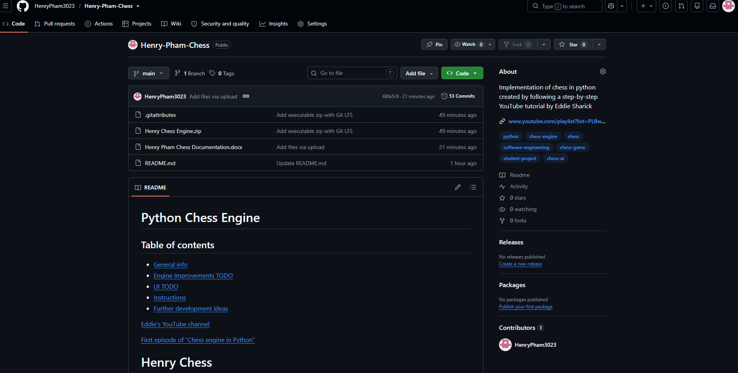
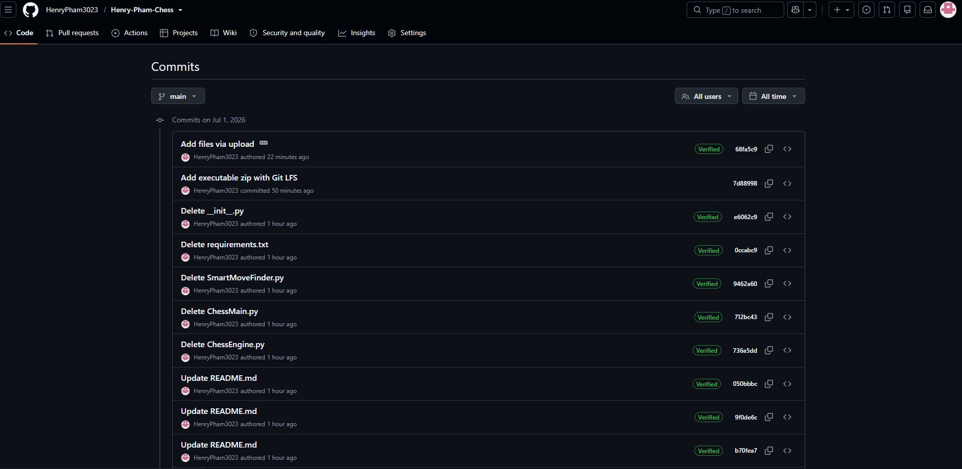
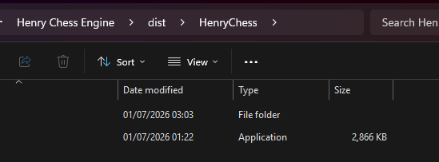
GitHub, Deployment & Handover
Release-ready evidence
GitHub repository with README and commit history
Executable built in dist/HenryChess
Stockfish placed in engines/stockfish/windows
ZIP distribution for users to extract and run
Henry Chess • Year 12 Software Engineering Major Project • Advanced desktop app • Python/Pygame • Stockfish review • PyInstaller deployment
Notes:
Use this slide to explain how the project is managed and deployed outside the IDE. Mention GitHub releases or the downloadable zip if used.

Slide 15
Challenges, Future Improvements & Live Demo
Major challenges
Future improvements
Live demo path
Legal move edge cases
AI speed vs strength balance
Puzzles applying the correct side to move
Stockfish path and executable packaging
Responsive layout and scrollable panels
Online multiplayer
Improved opening book
More validated puzzles
User accounts and progress tracking
Expanded accessibility options
Open executable
Start Vs AI game
Show premove + annotation
Open Practice Bots
Generate Game Review
Final reflection
This project demonstrates the complete software lifecycle: planning, coding, debugging, user feedback, source acknowledgement, testing, documentation, GitHub management and deployment.
Questions?
Slide 15 • Demo handover and final reflection
Notes:
Finish by preparing to demonstrate the executable live. Connect back to the criteria: tools, testing, security, challenges and live demonstration.

